Slide 1
Student Database with Smart Attendance System
By-Abdullah Abdul Sattar Shaikh(1BI18CS003)
& Atharva C.J(1BI18CS032)

Slide 2
Introduction
In this project we are creating a student attendance database system with the implementation of facial recognition.
This system is able to recognise and detect and individuals face with only one sample with high accuracy.
If the system detects a face, it enters the credentials of the identified individual and the current timestamp form when he/she was detected.
We are using MySQL as our database Query language.
Front-end will be implemented using the web app frameworks React.JS and Node.JS.
Python along side OpenCV will be used for implementing facial recognition unit.

Slide 3
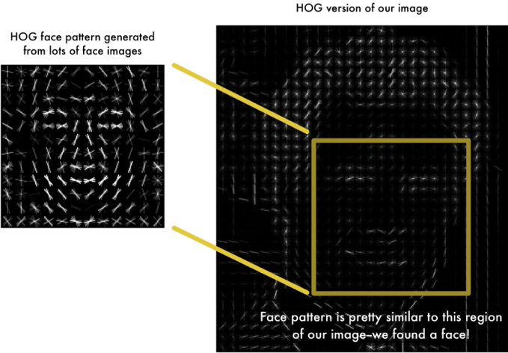
Facial recognition(optional)
Encode a picture using the HOG(Histogram of Oriented Gradients) algorithm to create a simplified version of the image. Using this simplified image, find the part of the image that most looks like a generic HOG encoding of a face.
Figure out the pose of the face by finding the main landmarks in the face. Once we find those landmarks, use them to warp the image so that the eyes and mouth are centered.
Pass the centered face image through a neural network that knows how to measure features of the face. Save those 128 measurements.
Looking at all the faces we’ve measured in the past, see which person has the closest measurements to our face’s measurements. That’s our match!

Slide 4
ER Diagram

Slide 5
ER Diagram (contd.)

Slide 6
Application
Most offices and government buildings use biometric systems for logging in work hours and restricting access to only those people that are permitted. Although facial recognition is now being implemented in many countries for this purpose, they still largely rely on fingerprint sensors because of the lower chance of duplication and fraud. The downside to this is that recording a fingerprint is a task that requires relatively more effort.
This system will be able to mark down multiple entries with almost zero human interaction and no extra hassle.
The most common places to implement a facial recognition database system are used in places like hospitals ,banks , concerts etc where it becomes so crowded that verifying each and every soul becomes impractical.
By far the most interesting implementation of facial recognition in attendance systems is that of event attendance. The deployment of this system poses many benefits, especially for large gatherings (eg schools , colleges etc).

